Slide 1
IT4409: Web Technologies and e-Services
Term 2020-2
Instructor: Dr. Thanh-Chung Dao
Slides by Dr. Binh Minh Nguyen
Department of Information Systems
School of Information and Communication Technology
Hanoi University of Science and Technology

Slide 2
Reasonable Questions
What is the World Wide Web?
Is it the same thing as the Internet?
Who invented it?
How old is it?
How does it work?
What kinds of things can it do?
What does it have to do with programming?
Notes:
invent (invent) sáng chế

Slide 3
Web ≠ Internet
Internet : a physical network connecting millions of computers using the same protocols for sharing/transmitting information (TCP/IP)
  in reality, the Internet is a network of smaller networks
World Wide Web: a collection of interlinked multimedia documents that are stored on the Internet and accessed using a common protocol (HTTP)
Key distinction: Internet is hardware; Web is software along with data, documents, and other media
Many other Internet-based applications exist
e.g., email, telnet, ftp, usenet, instant messenging services, file-sharing services, …
Notes:
Transmission Control Protocol (TCP) and the Internet Protocol (IP): provides end-to-end connectivity specifying how data should be packetized, addressed, transmitted, routed and received at the destination.
abbreviate: viết tắt
HTTP: Hypertext Transfer Protocol (HTTP) - is the foundation of data communication for the World Wide Web.

Slide 4
(A Very Brief) History of the Internet
the idea of a long-distance computer network traces back to early 60's
  Joseph Licklider at M.I.T. (a “time-sharing network of computers”)
  Paul Baran at Rand (tasked with designing a “survivable” communications system that could maintain communication between end points even after damage from a nuclear attack)
  Donald Davies at National Physics Laboratory in U.K.
in particular, the US Department of Defense was interested in the development of distributed, decentralized networks
  survivability (i.e., network still functions despite a local attack)
  fault-tolerance (i.e., network still functions despite local failure)
  contrast with phone system, electrical system which are highly centralized services
Notes:
- trace: lần theo
At some point: tới một lúc nào đó
survivable: có thể tồn tại
Joke: lời nói đùa

Slide 5
The Internet
In 1969, Advanced Research Project Agency funded the ARPANET
  connected computers at UC Los Angeles, UC Santa Barbara, Stanford Research Institute, and University of Utah
  allowed researchers to share data, communicate
    56Kb/sec communication lines (vs. 110 b/sec over phone lines)
Technical origin
  One of earliest attempts to network heterogeneous, geographically dispersed computers
  Email first available on ARPANET in 1972 (and quickly very popular!)
Notes:
- disperse (dispersi): rải rác

Slide 6
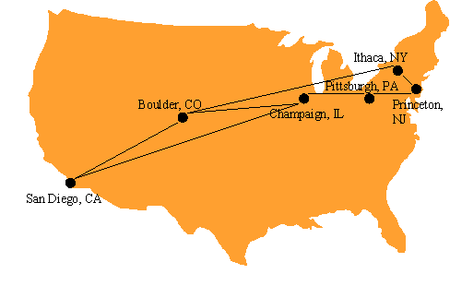
The Internet
Open-access networks
  Regional university networks (e.g., SURAnet)
  CSNET for CS departments not on ARPANET
NSFNET (1985-1995)
  Primary purpose: connect supercomputer centers
  Secondary purpose: provide backbone to connect regional networks
  The 6 supercomputer centers connected by the early NSFNET backbone

Slide 7
Internet Growth
throughout the 70's, the size of the ARPANET doubled every year
  first ARPANET e-mail sent in 1971
  decentralization mades adding new computers easy
  TCP/IP developed in the mid 1970s for more efficient packet routing
  migration of ARPANET to TCP/IP completed 1 January, 1983
  ~1000 military & academic host computers connected by 1984
in 80‘s, U.S. government took a larger role in Internet development
  created NSFNET for academic research in 1986
  ARPANET was retained for military & government computers
by 90's, Internet connected virtually all colleges & universities
  businesses and individuals also connecting as computing costs fell
  ~1,000,000 computers by 1992
in 1992, control of the Internet was transferred to a non-profit organizations
  Internet Society: Internet Engineering Task Force
  Internet Architecture Board
  Internet Assigned Number Authority
  World-Wide-Web Consortium (W3C)
  . . .
Notes:
twice: gấp đôi
Original NSFNET backbone speed: 56 kbit/s
Upgraded to 1.5 Mbit/s (T1) in 1988
Upgraded to 45 Mbit/s (T3) in 1991
In 1988, networks in Canada and France connected to NSFNET
In 1990, ARPANET is decommissioned, NSFNET the center of the internet

Slide 8
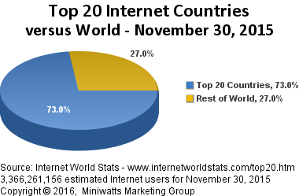
Internet Growth (cont.)
Year | Computers on the Internet (at any one time?)
2011 | ~605,000,000
2006 | 439,286,364
2004 | 285,139,107
2002 | 162,128,493
2000 | 93,047,785
1998 | 36,739,000
1996 | 12,881,000
1994 | 3,212,000
1992 | 992,000
1990 | 313,000
1988 | 56,000
1986 | 5,089
1984 | 1,024
1982 | 235
Internet has exhibited exponential growth,
doubling in size every 1-2 years
(stats from Internet Software Consortium)
United Kingdom has 52.7 million users (approx. 83.6% of the population)

Slide 9
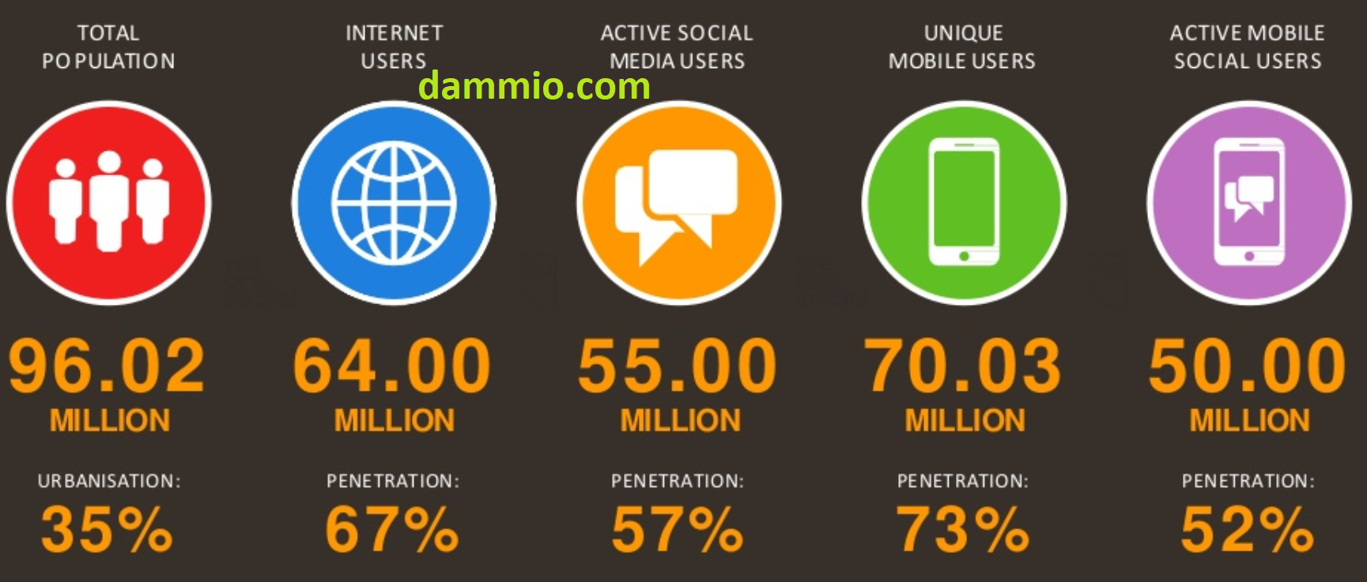
Internet users in Vietnam
From dammio

Slide 10
(A Very Brief) History of the Web
the idea of hypertext (cross-linked and inter-linked documents) traces back to Vannevar Bush in the 1940's
  online hypertext systems began to be developed in 1960's
    e.g., Ted Nelson and Andy van Dam's Hypertext Editing System (HES), Doug Englebert's NLS (oN-Line System)
  in 1987, Apple introduced HyperCard (a hypermedia system that predated the WWW)
in 1989, Tim Berners-Lee at the European Particle Physics Laboratory (CERN) designed a hypertext system for linking documents over the Internet
  designed a (Non-WYSIWYG) language for specifying document content
    evolved into HyperText Markup Language (HTML)
  designed a protocol for downloading documents and interpreting the content
    evolved into HyperText Transfer Protocol (HTTP)
  implemented the first browser -- text-based, no embedded media
    the Web was born!
Notes:
Hypertext is text displayed on a computer display or other electronic devices with references (hyperlinks) to other text which the reader can immediately access
-predate: (prideit): quay về (lùi về) thời gian

Slide 11
History of the Web (cont.)
the Web was an obscure, European research tool until 1993
in 1993, Marc Andreessen and Eric Bina (at the National Center for Supercomputing Applications, a unit of the University of Illinois) developed Mosaic, one of the early graphical Web browsers that popularized the WWW for the general public (Erwise was the first one, ViolaWWW the second)
  the intuitive, clickable interface helped make hypertext accessible to the masses
  made the integration of multimedia (images, video, sound, …) much easier
  Andreessen left NCSA to found Netscape in 1994
    cheap/free browser further popularized the Web (75% market share in 1996)
in 1995, Microsoft came out with Internet Explorer
Opera web browser released in 1996
    Netscape bought by AOL in 1998 for US$4.2 billion in stock
    Firefox web browser, version 1.0, released in 2004
    Google Chrome released in 2008
today, the Web is the most visible aspect of the Internet
Notes:
- obscure: vô danh, ít người biết đến

Slide 12
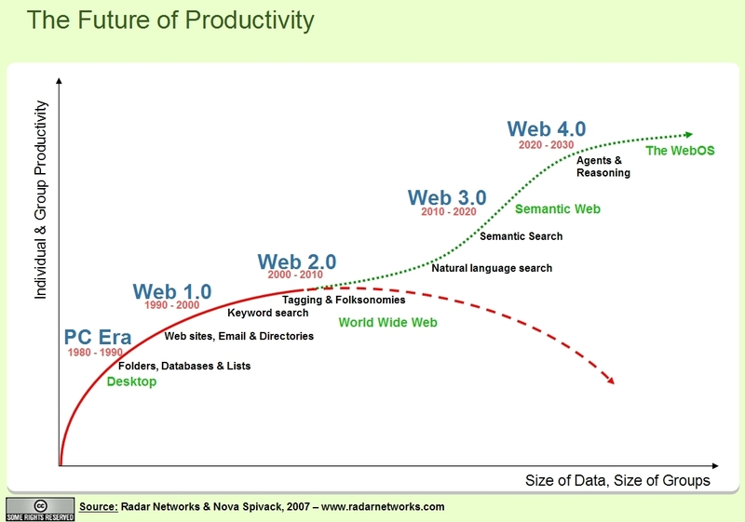


Slide 13
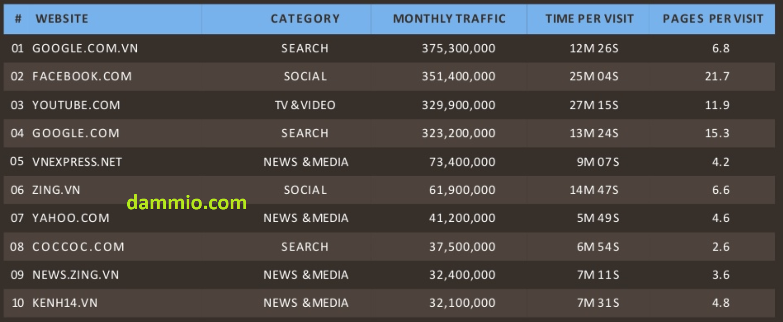
Popular websites in Vietnam
From dammio

Slide 14
World Wide Web
The Web is the collection of machines (Web servers) on the Internet that provide information, particularly HTML documents, via HTTP.
Machines that access information on the Web are known as Web clients. A Web browser is software used by an end user to access the Web.
Notes:
HTML or HyperText Markup Language

Slide 15
Hypertext Transport Protocol (HTTP)
HTTP is based on the request-response communication model:
  Client sends a request
  Server sends a response
HTTP is a stateless protocol:
  The protocol does not require the server to remember anything about the client between requests.

Slide 16
HTTP
Normally implemented over a TCP connection (80 is standard port number for HTTP)
Typical browser-server interaction:
  User enters Web address in browser
  Browser uses DNS to locate IP address
  Browser opens TCP connection to server
  Browser sends HTTP request over connection
  Server sends HTTP response to browser over connection
  Browser displays body of response in the client area of the browser window
Notes:
The Domain Name System (DNS) is a hierarchical distributed naming system for computers, services, or any resource connected to the Internet or a private network

Slide 17
HTTP Request
Structure of the request:
  start line
  header field(s)
  blank line
  optional body

Slide 18
HTTP Request
Structure of the request:
  start line
  header field(s)
  blank line
  optional body

Slide 19
HTTP Request
Start line
  Example: GET / HTTP/1.1
Three space-separated parts:
  HTTP request method
  Request-URI (Uniform Resource Identifier)
  HTTP version

Slide 20
HTTP Request
Start line
  Example: GET / HTTP/1.1
Three space-separated parts:
  HTTP request method
  Request-URI
  HTTP version
    We will cover 1.1, in which version part of start line must be exactly as shown

Slide 21
HTTP Request
Start line
  Example: GET / HTTP/1.1
Three space-separated parts:
  HTTP request method
  Request-URI
  HTTP version

Slide 22
HTTP Request
Uniform Resource Identifier (URI)
  Syntax: scheme : scheme-depend-part
    Ex: in http://www.example.com/
    the scheme is http
  Request-URI is the portion of the requested URI that follows the host name (which is supplied by the required Host header field)
    Ex: / is Request-URI portion of http://www.example.com/
Notes:
- portion: phần chia

Slide 23
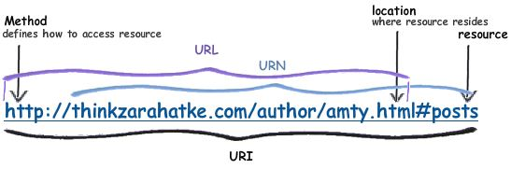
URI
URI’s are of two types:
  Uniform Resource Name (URN)
    Can be used to identify resources with unique names, such as books (which have unique ISBN’s)
    Scheme is urn
  Uniform Resource Locator (URL)
    Specifies location at which a resource can be found
    In addition to http, some other URL schemes are https, ftp, mailto, and file

Slide 24
HTTP Response
Structure of the response:
  status line
  header field(s)
  blank line
  optional body

Slide 25
HTTP Response
Structure of the response:
  status line
  header field(s)
  blank line
  optional body

Slide 26
HTTP Response
Status line
  Example: HTTP/1.1 200 OK
Three space-separated parts:
  HTTP version
  status code
  reason phrase (intended for human use)
Notes:
intend (intend): dự định

Slide 27
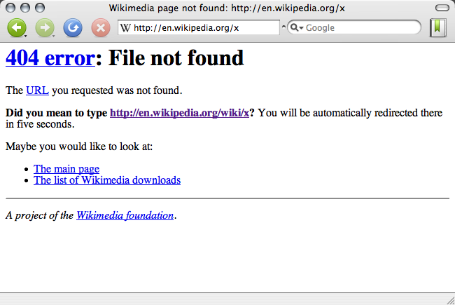
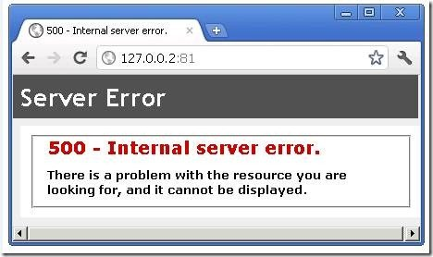
HTTP Response
Status code
  Three-digit number
  First digit is class of the status code:
    1=Informational
    2=Success
    3=Redirection (alternate URL is supplied)
    4=Client Error
    5=Server Error
  Other two digits provide additional information
  See http://www.w3.org/Protocols/rfc2616/rfc2616-sec10.html

Slide 28
HTTP Response
Structure of the response:
  status line
  header field(s)
  blank line
  optional body

Slide 29
HTTP Response
Common header fields:
  Connection, Content-Type, Content-Length
  Date: date and time at which response was generated (required)
  Location: alternate URI if status is redirection
  Last-Modified: date and time the requested resource was last modified on the server
  Expires: date and time after which the client’s copy of the resource will be out-of-date
  ETag: a unique identifier for this version of the requested resource (changes if resource changes)
Notes:
alternate (o.ternet): dự khuyết
expire: (expaiờ): thời hạn

Slide 30
HTTP Request/Response Examples
Connect
{
$ telnet www.example.org 80
Trying 192.0.34.166...
Connected to www.example.com (192.0.34.166).
Escape character is ’^]’.
GET / HTTP/1.1
Host: www.example.org
HTTP/1.1 200 OK
Date: Thu, 09 Oct 2003 20:30:49 GMT
…
{
Send
Request
{
Receive
Response
Notes:
Telnet is a network protocol used on the Internet or local area networks to provide a bidirectional interactive text-oriented communication facility using a virtual terminal connection.
- bidirectional interactive: tương tác 2 chiều

Slide 31
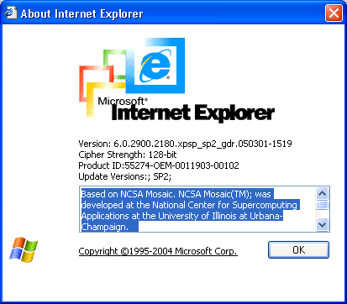
Web Browsers
First graphical browser running on general-purpose platforms:

Slide 32
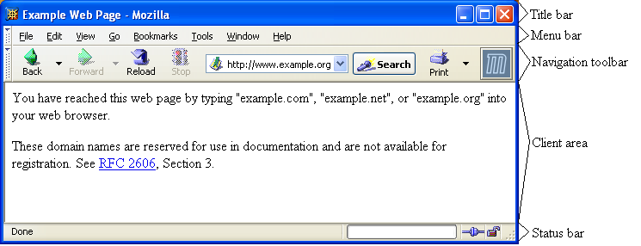
Web Browsers

Slide 33
Web Browsers
Primary tasks:
  Convert web addresses (URL’s) to HTTP requests
  Communicate with web servers via HTTP
  Render (appropriately display) documents returned by a server

Slide 34
Static vs. Dynamic pages
most Web pages are static
  contents (text/links/images) are the same each time it is accessed
  e.g., online documents, most homepages
  HyperText Markup Language (HTML) is used to specify text/image format
as the Web continues to move towards more and more online services and e-commerce continues to grow, Web pages must also provide dynamic content
  pages can be fluid, changeable (e.g., rotating banners)
  must be able to react to the user's actions, request and process info, tailor services
  e.g., amazon.com
this course is about applying your programming skills to the development of dynamic Web pages and applications
Notes:
purpose of static web
fluid: (flu.id) hay thay đổi
habits thói quen
react (riakt): phản ứng lại

Slide 35
Web server/client
Client
Server
Browser
1. HTTP request for image
Web
Server
2. HTTP response containing image

Slide 36
Client Caching
Client
Server
1. HTTP request for image
Browser
Web
Server
2. HTTP response containing image
3. Store image
Cache

Slide 37
Client Caching
Client
Server
Browser
Web
Server
I need that
image
again…
Cache

Slide 38
Client Caching
Client
Server
Browser
Web
Server
This…
HTTP request for image
I need that
image
again…
HTTP response containing image
Cache

Slide 39
Client Caching
Client
Server
Browser
Web
Server
I need that
image
again…
Get
image
… or this
Cache

Slide 40
Client Caching
Cache advantages
  (Much) faster than HTTP request/response
  Less network traffic
  Less load on server
Cache disadvantage
  Cached copy of resource may be invalid (inconsistent with remote version)

Slide 41
Web Clients
Many possible web clients:
  Text-only “browser” (lynx)
  Mobile phones
  Robots (software-only clients, e.g., search engine “crawlers”)
  etc.
We will focus on traditional web browsers

Slide 42
Web Servers
Basic functionality:
  Receive HTTP request via TCP
  Map host header (domain name) to specific virtual host (one of many host names sharing an IP address)
  Map Request-URI to specific resource associated with the virtual host
    File: Return file in HTTP response
    Program: Run program and return output in HTTP response
  Map type of resource to appropriate MIME type and use to set Content-Type header in HTTP response
  Log information about the request and response
Notes:
appropriate: (approupriaet): thích hợp
- MIME (Multipurpose Internet Mail Extensions) specification. They are also sometimes referred to as Content-types.

Slide 43
Web Servers
httpd: UIUC, primary Web server c. 1995
Apache: “A patchy” version of httpd, now the most popular server (esp. on Linux platforms)
IIS: Microsoft Internet Information Server
Tomcat:
  Java-based
  Provides container (Catalina) for running Java servlets (HTML-generating programs) as back-end to Apache or IIS
  Can run stand-alone using Coyote HTTP front-end
Notes:
University of Illinois (illinois)

Slide 44
Client-Side Programming
can download program with Web page, execute on client machine
  simple, generic, but sometimes insecure
JavaScript
  a scripting language for Web pages, developed by Netscape in 1995
  uses a C++/Java-like syntax, so familiar to programmers, but simpler
  good for adding dynamic features to Web page, controlling forms and GUI
  requires users to have this technology enabled on their browsers
  see http://www.w3schools.com/js/
Java applets
  can define small, special-purpose programs in Java called applets
  provides (almost) full expressive power of Java (but with more overhead)
  good for more complex tasks or data heavy tasks, such as graphics
  see http://java.sun.com/applets/
Notes:
- malicious (malisiờs)

Slide 45
Server-Side Programming
can store and execute program on Web server, link from Web page
  more complex, requires server privileges, but can still be (mostly) secure
Common Gateway Interface (CGI) programming
  programs can be written to conform to the CGI
  when a Web page submits, data from the page is sent as input to the CGI program
  CGI program executes on server, sends its results back to browser as a Web page
  good if computation is large/complex or requires access to private data
Active Server Pages (ASP), Java Servlets, PHP, Server Side Includes, Ajax
  some of these are vendor-specific alternatives to CGI (such as Microsoft’s ASP)
  provide many of the same capabilities as CGI programs but using HTML-like tags
  some of these technologies might require functionality to be enabled in the client’s browser (e.g. Ajax generally requires the use of Javascript combined with PHP or some other server-based programming component)
Notes:
- privileges: (privơlidz): đặc quyền

Slide 46
Q&A
email: chungdt@soict.hust.edu.vn

